Slide 1
BOOK RECOMMENDATION SYSTEM (P-307) GROUP-2
ROHAN KUMAR SUDIPTA DAS
NIKHITHA K R ANJAIL NITIN GAIKWAD MOHAN SAMADHAN PATIL

Slide 2
INTRODUCTION
A recommendation system filters information by predicting ratings or preferences of customers for items that the customers would like to use. It tries to recommend items to the customers according to their needs and taste.
The system analyses the books that were liked by the customer with the unrated books, potentially looking for best-suited content to recommend them.

Slide 3
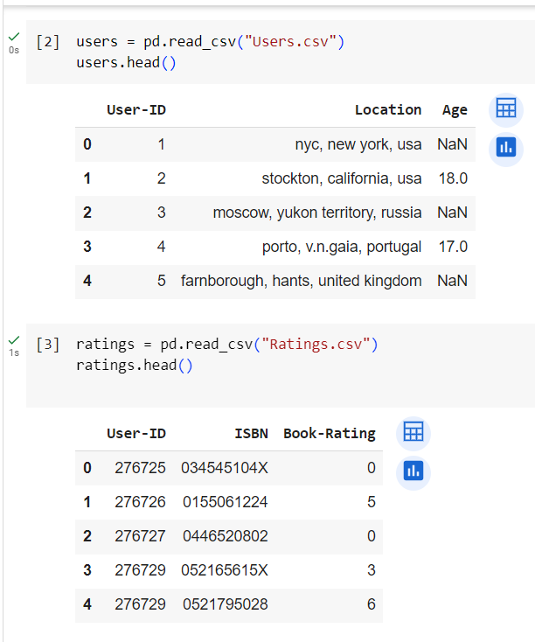
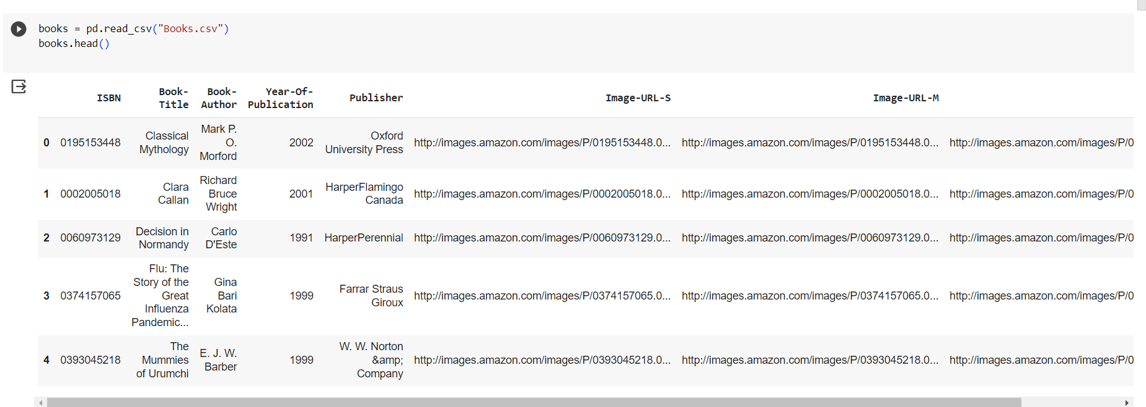
DATA INFORMATION

Slide 4
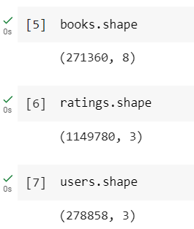
Dimension of dataset

Slide 5
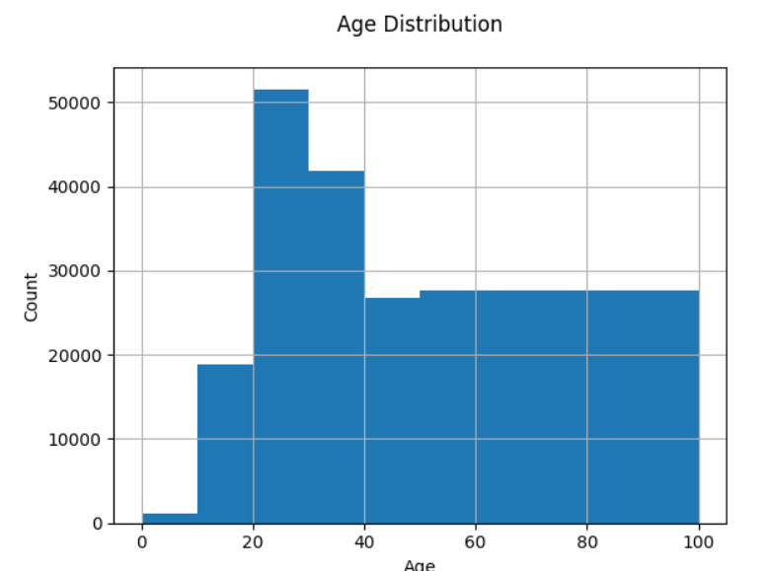
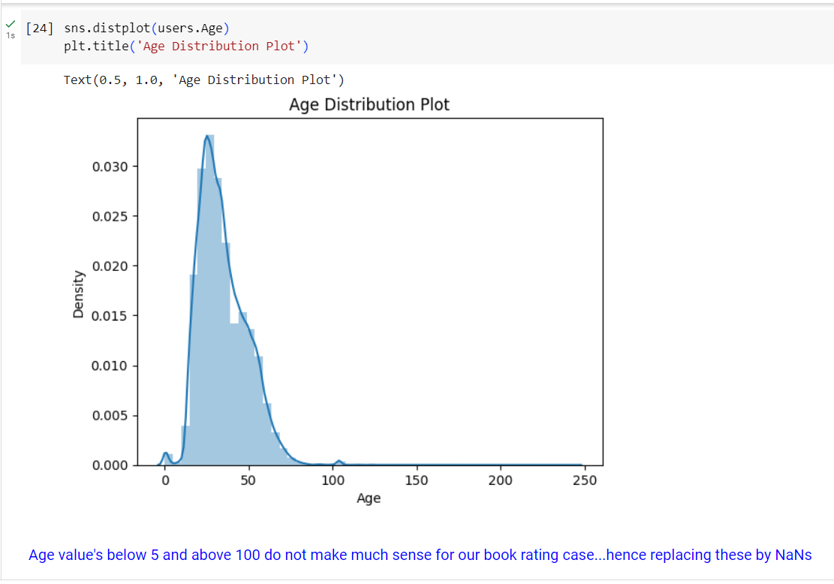
Users Dataset Age: Let’s understand the Age distribution of the given user dataset. By using a distplot for the Age column we can get the distribution of ages and the density. Below is the distplot.

Slide 6
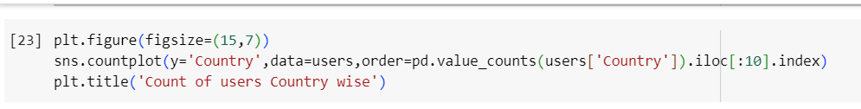
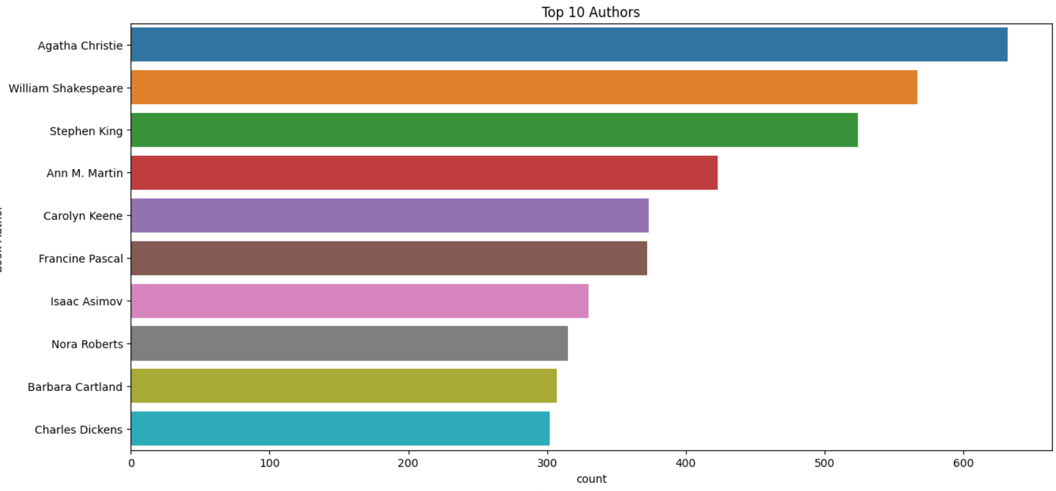
Location

Slide 7
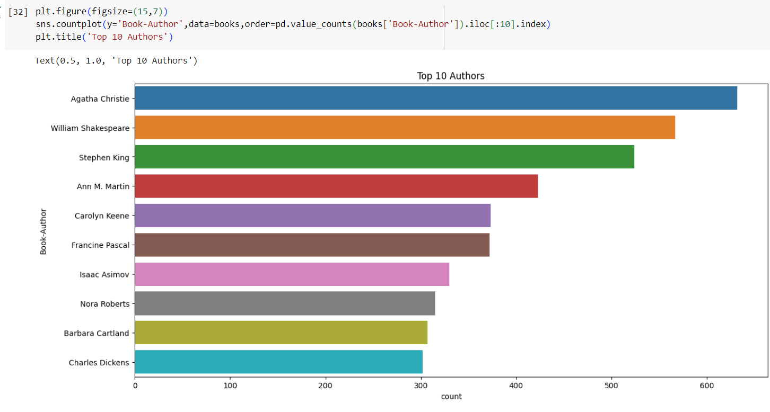
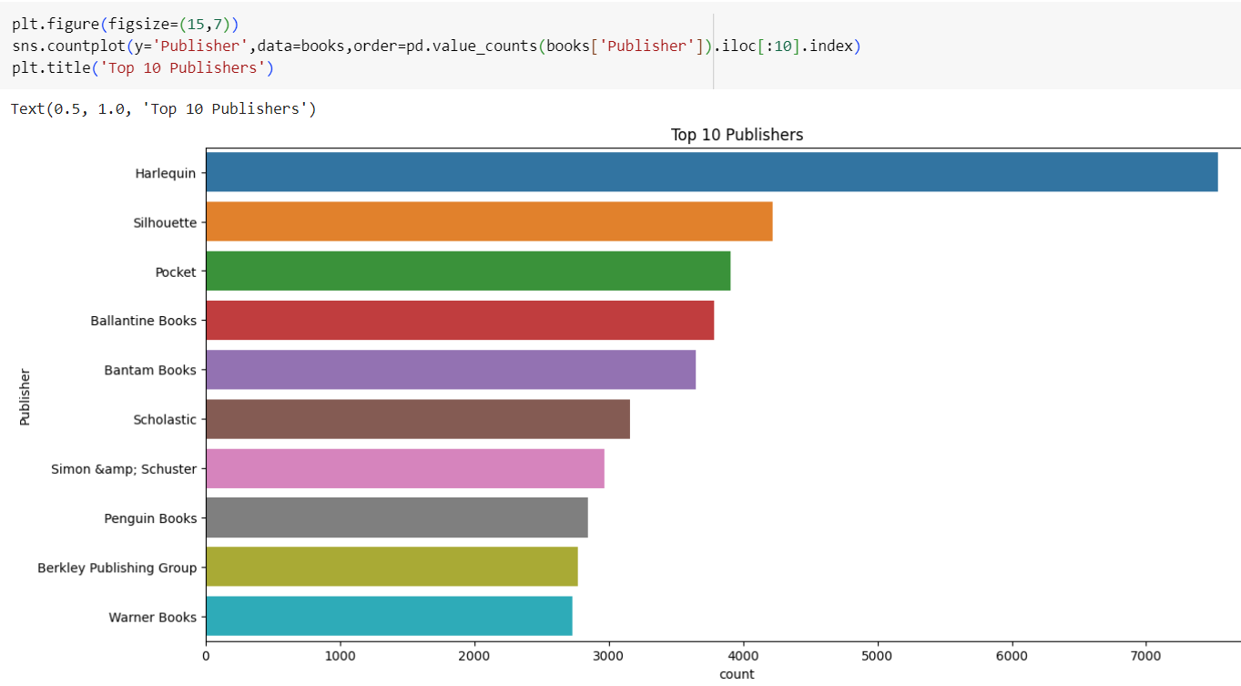
Book Dataset From the count plot, let’s find the top 10 Book-Author and top 10 Book-Publishers. Further we find that both the plots are skewed and the maximum number of books are from top 10 Book-Authors and top 10 Book-Publishers.

Slide 8
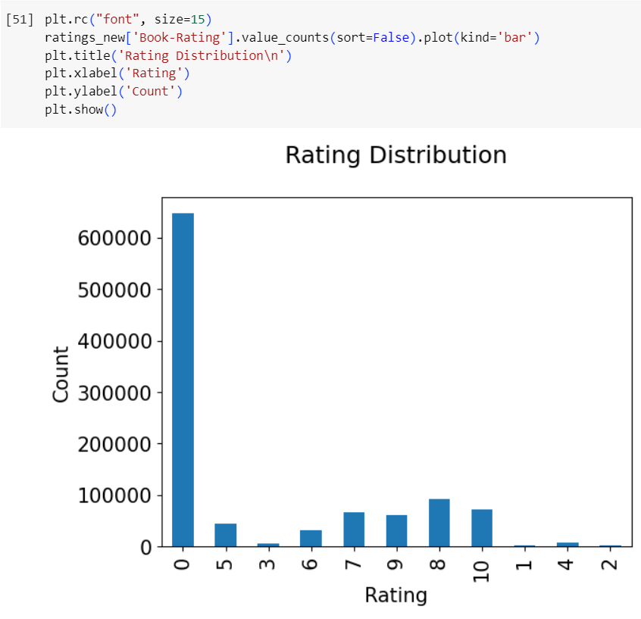
Ratings Dataset

Slide 9
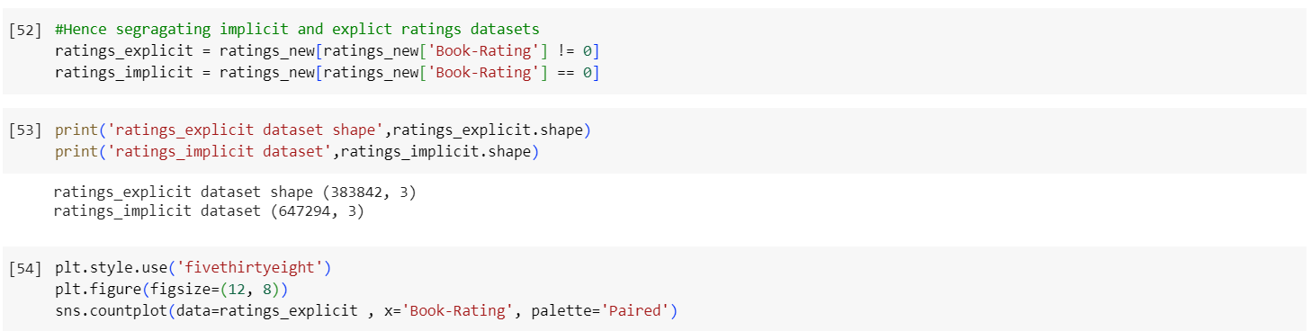
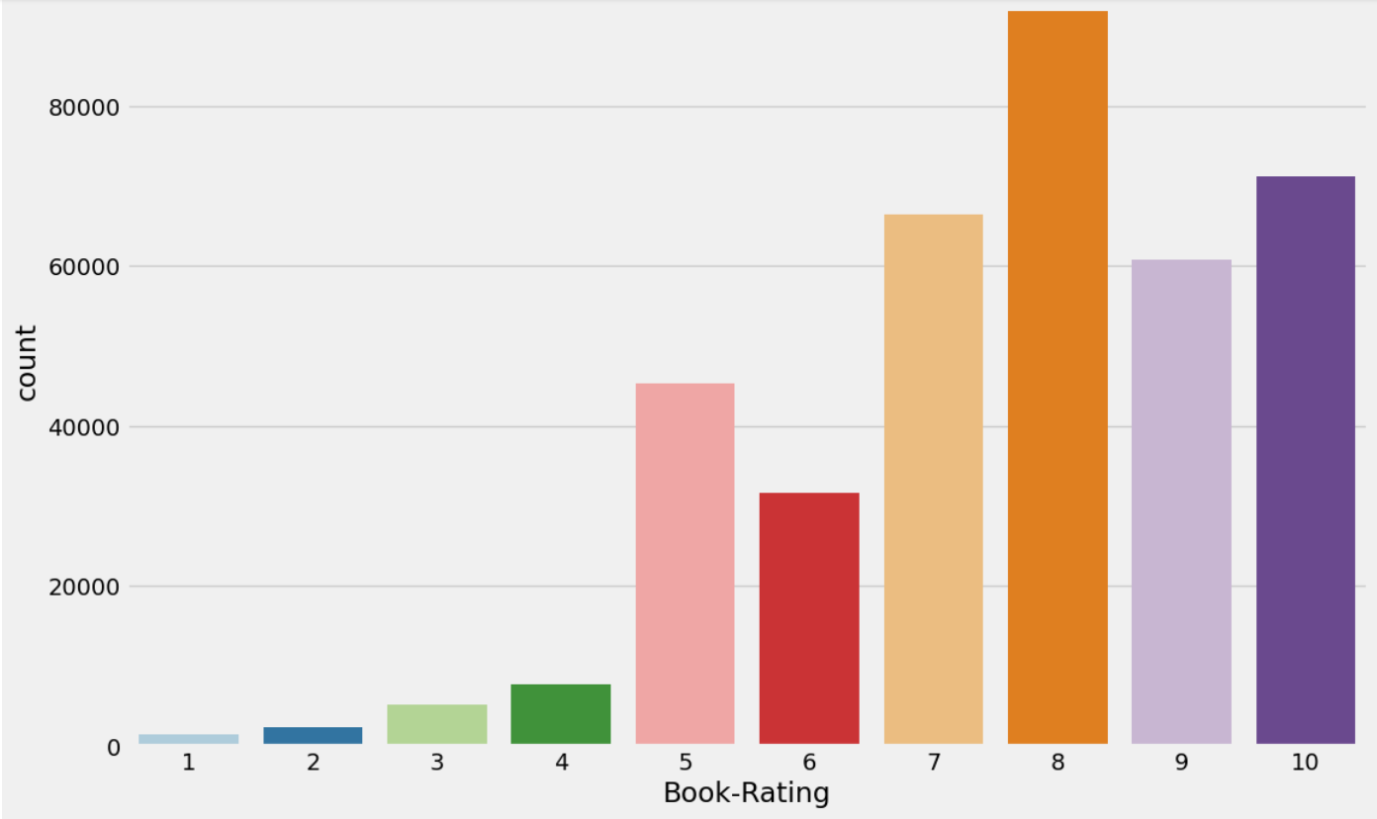
The ratings are very unevenly distributed, and the vast majority of ratings are 0 .As quoted in the description of the dataset - BX-Book-Ratings contains the book rating information. Ratings are either explicit, expressed on a scale from 1-10 higher values denoting higher appreciation, or implicit, expressed by 0.Hence segragating implicit and explict ratings datasets

Slide 10
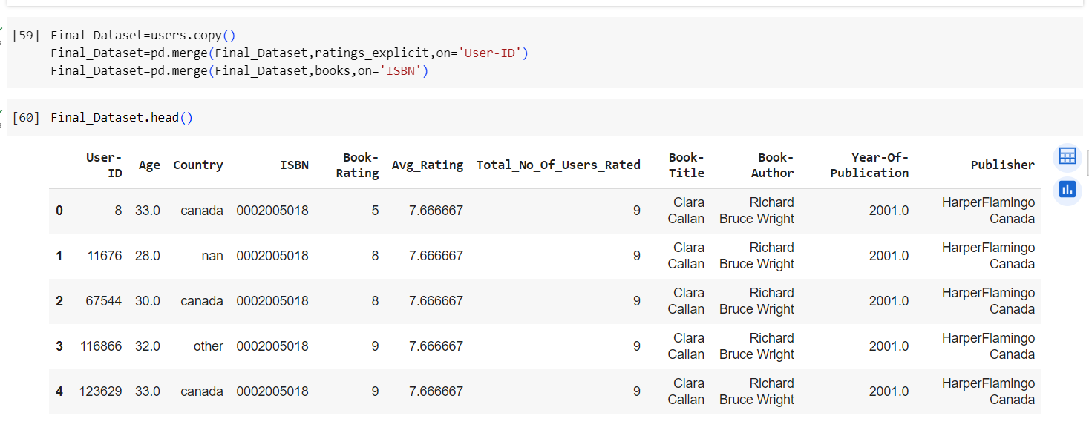
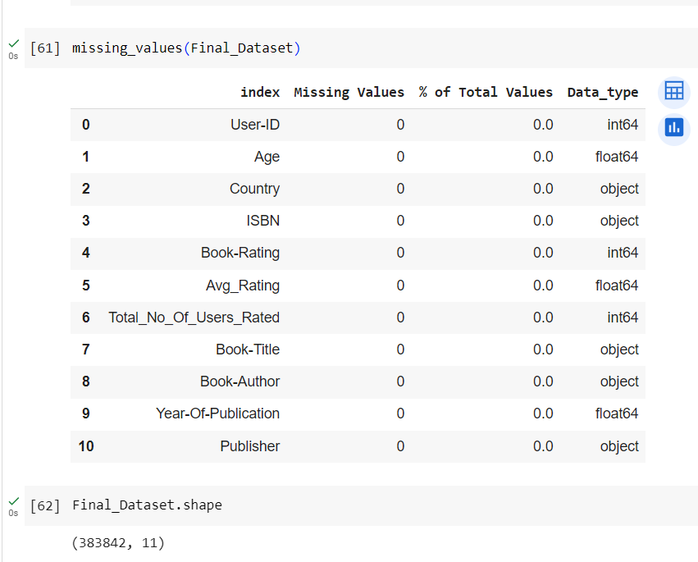
Merging All Dataset

Slide 11
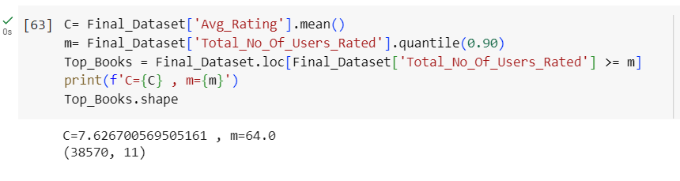
Popularity Based Filtering

Slide 12
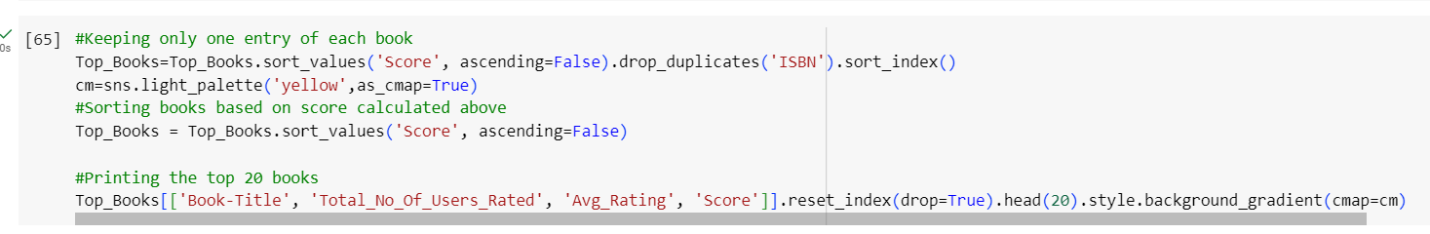
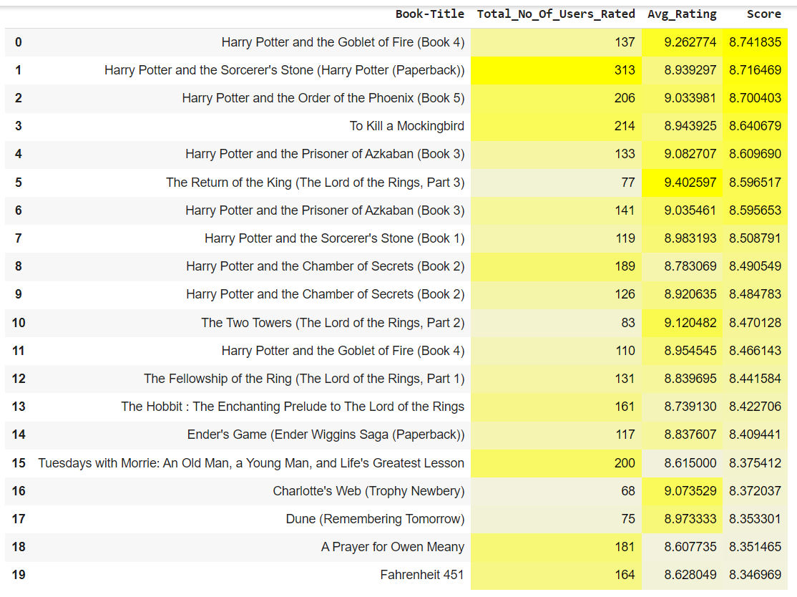
Here we used 90th percentile as our cutoff. In other words, for a book to feature in the charts, it must have more votes than at least 90% of the books in the list. We see that there are 38570 books which qualify to be in this list. Now, we need to calculate our metric for each qualified book. To do this, we will define a function, weighted_rating() and define a new feature score, of which we’ll calculate the value by applying this function to our DataFrame of qualified books:

Slide 13
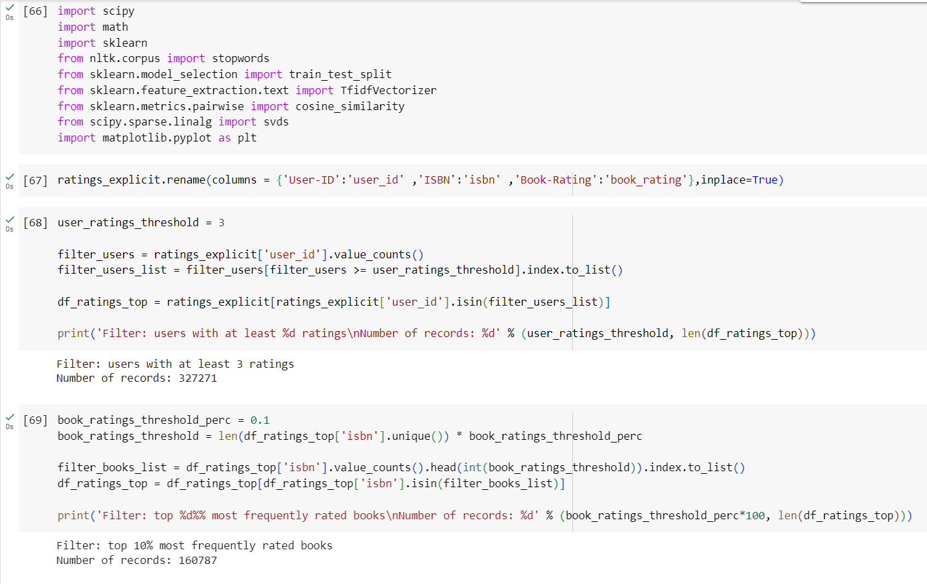
Model Based Collaborative Filtering This analysis will focus on book recommendations based on Book-Crossing dataset. To reduce the dimensionality of the dataset and avoid running into memory error we will focus on users with at least 3 ratings and top 10% most frequently rated books. The recommender systems will be built using surprise package (Matrix Factorization - based models)

Slide 14
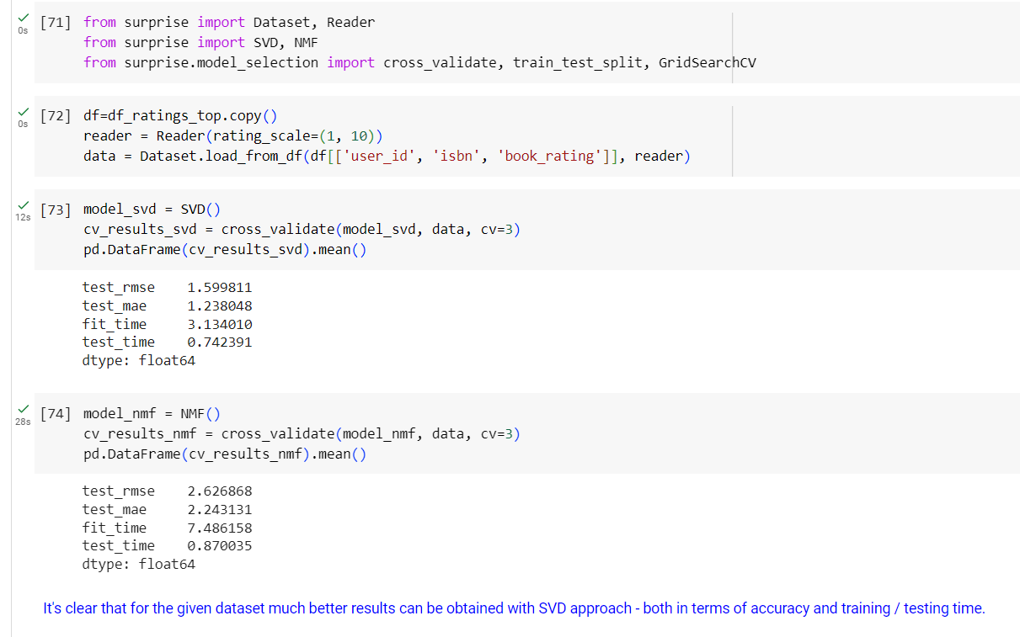
SVD and NMF models

Slide 15
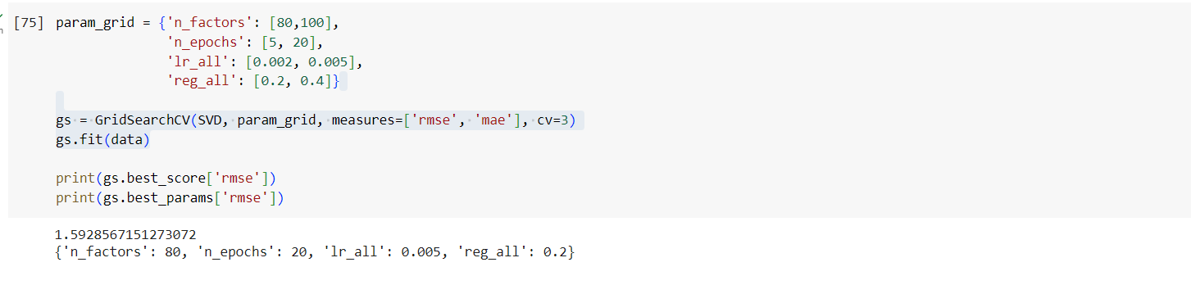
SVD algorithm As a result, regarding the majority of parameters, the default setting is the most optimal one. The improvement obtained with Grid Search is very small.

Slide 16
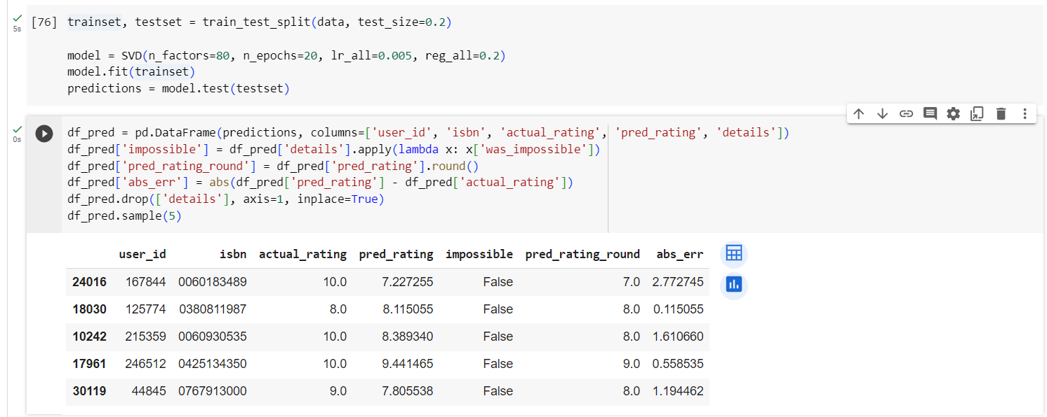
Collaborative Filtering model In this part, let's examine in detail the results obtained by the SVD model that provided the best RMSE score.

Slide 17
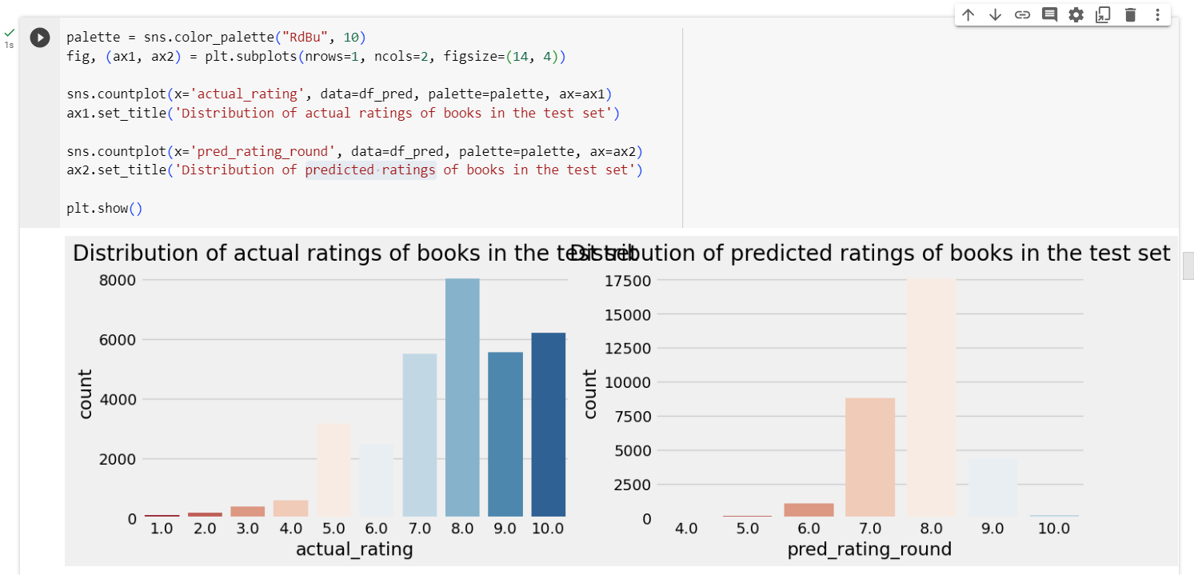
Distribution of actual ratings and predicted ratings of books in the test set.

Slide 18
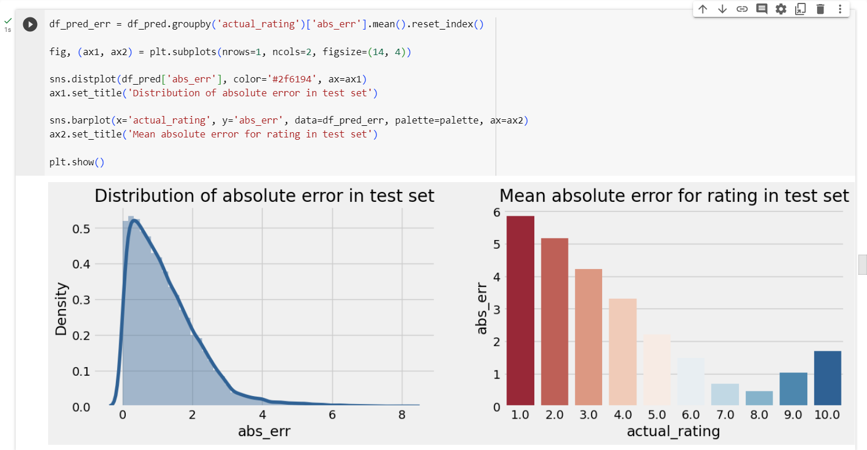
Absolute error of predicted ratings The distribution of absolute errors is right-skewed, showing that the majority of errors is small: between 0 and 1. There is a long tail that indicates that there are several observations for which the absolute error was close to 10.The model deals very well with predicting score = 8 (the most frequent value). The further the rating from score = 8, the higher the absolute error. The biggest errors happen to observations with scores 1 or 2 which indicates that probably the model is predicting high ratings for those observations.

Slide 19
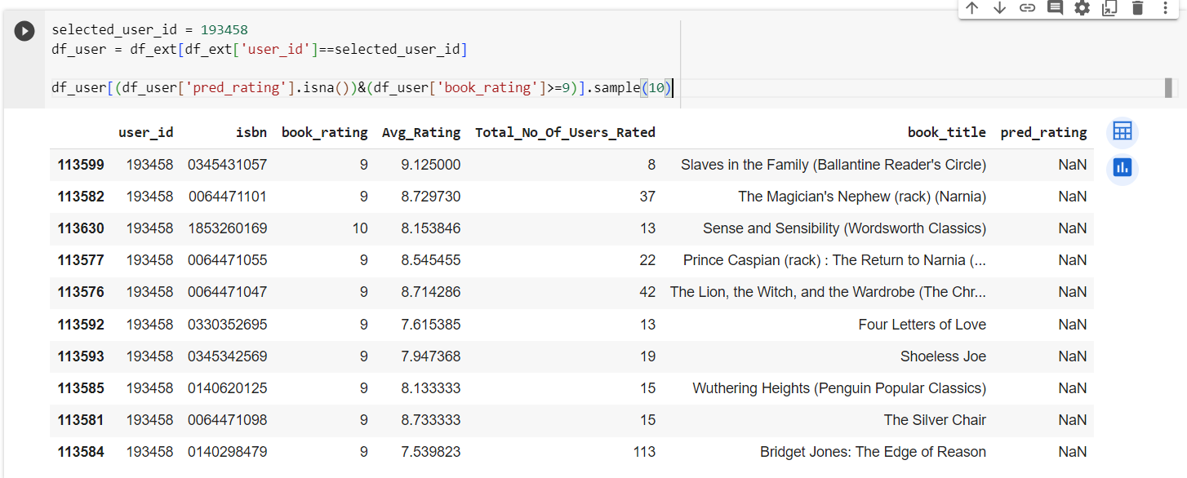
Train set: Top rated books

Slide 20
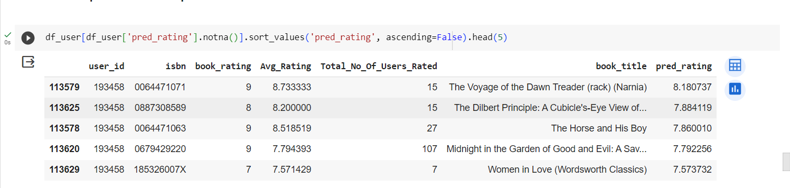
Test set: predicted top rated books

Slide 21
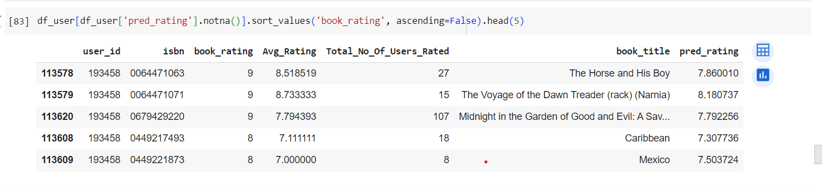
Test set: actual top rated books

Slide 22
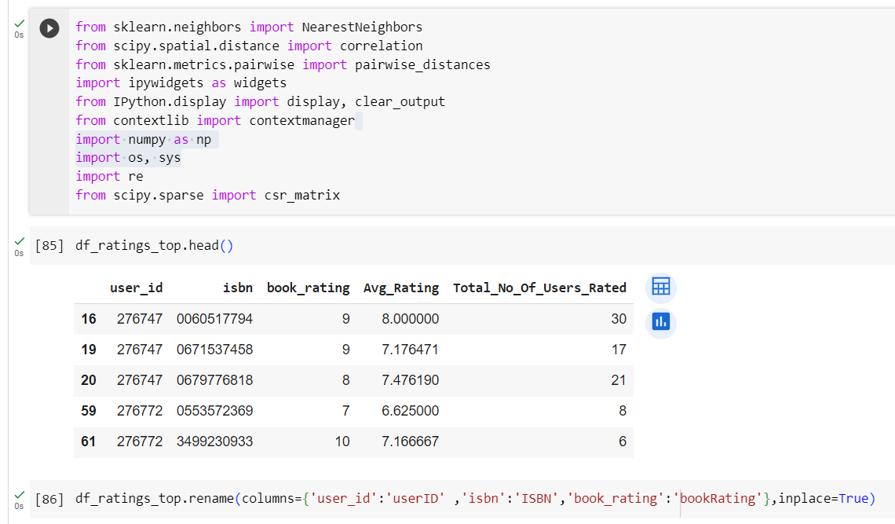
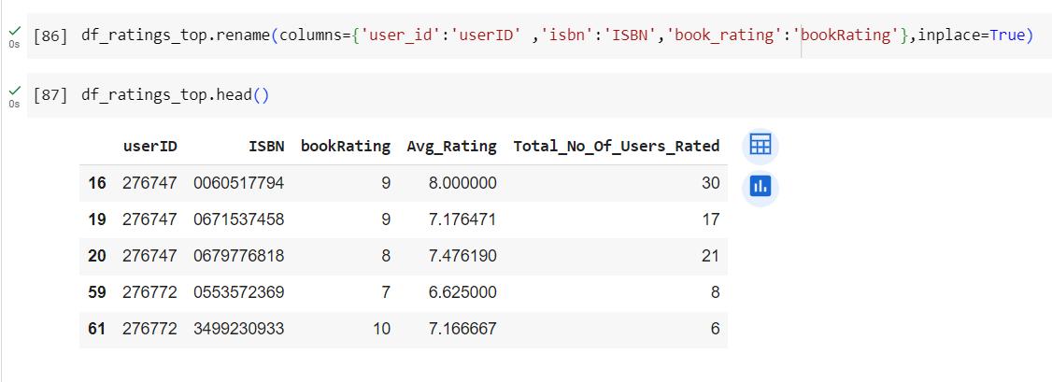
Collaborative Filtering based(Item-Item Based)

Slide 23
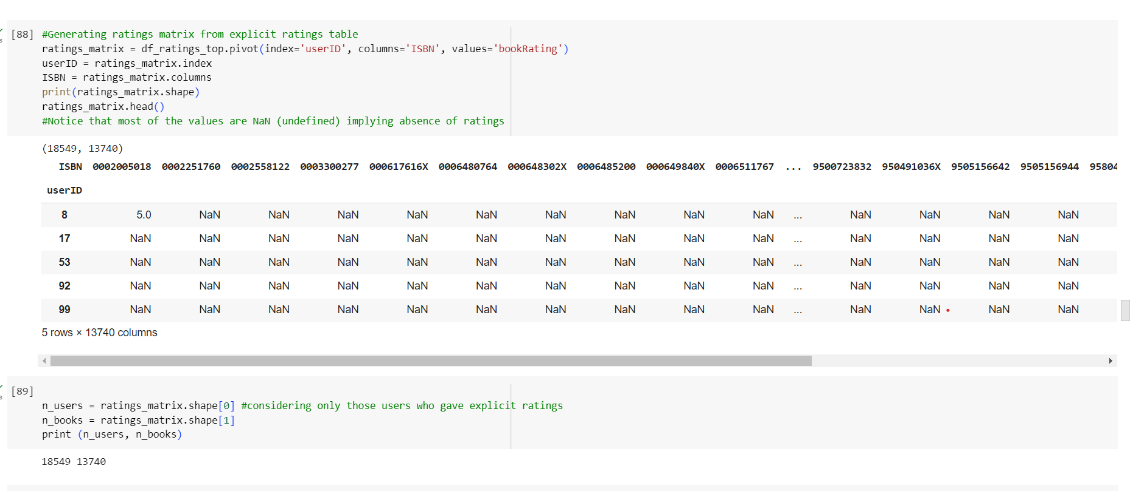
Implementing KNN

Slide 24
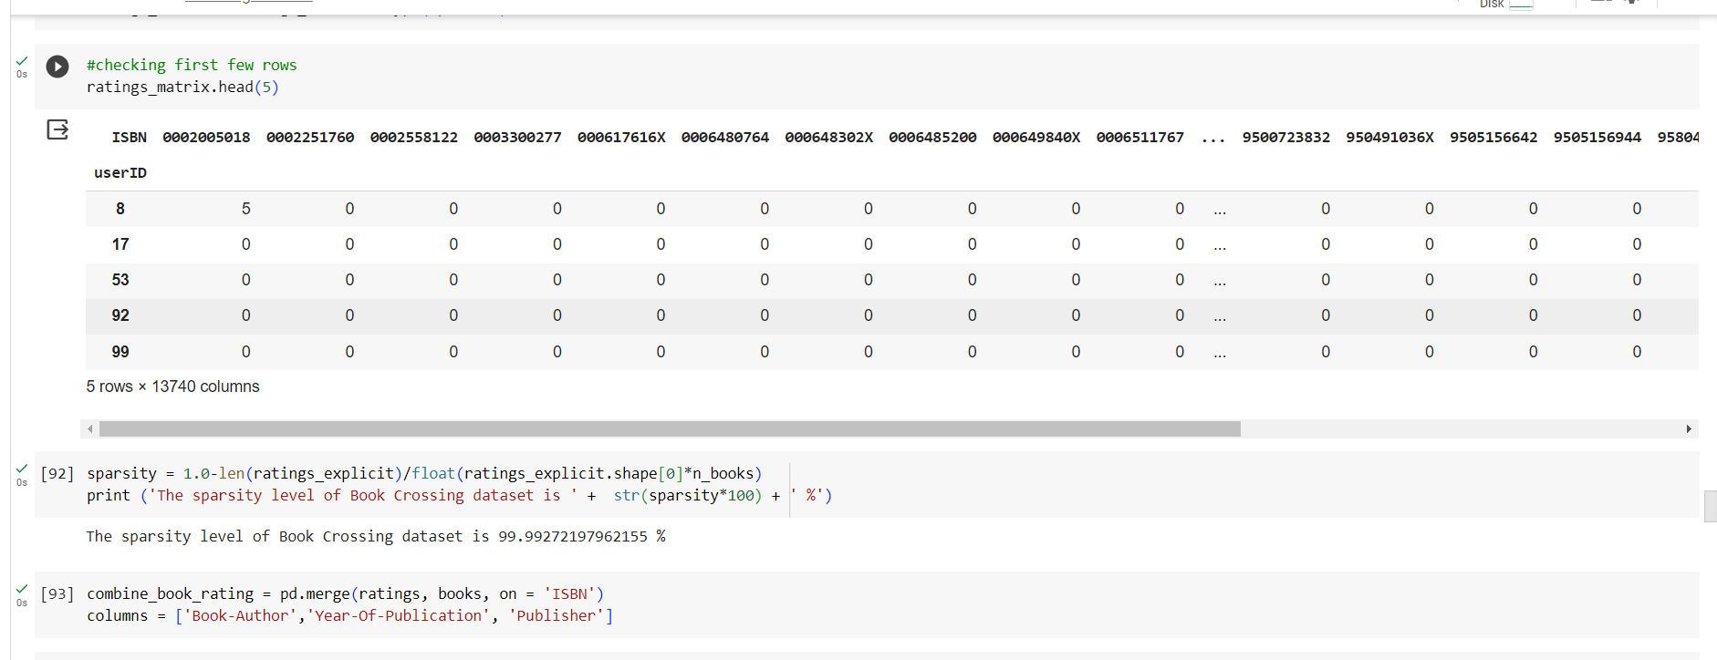

Slide 25
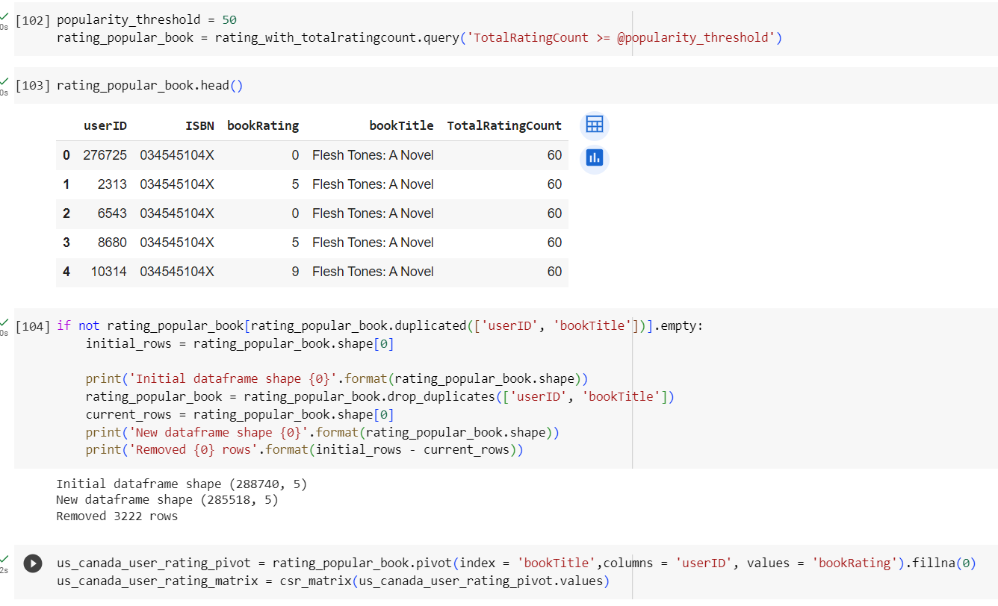
About 1% of the books received 50 or more ratings. Because we have so many books in our data, we will limit it to the top 1%.

Slide 26
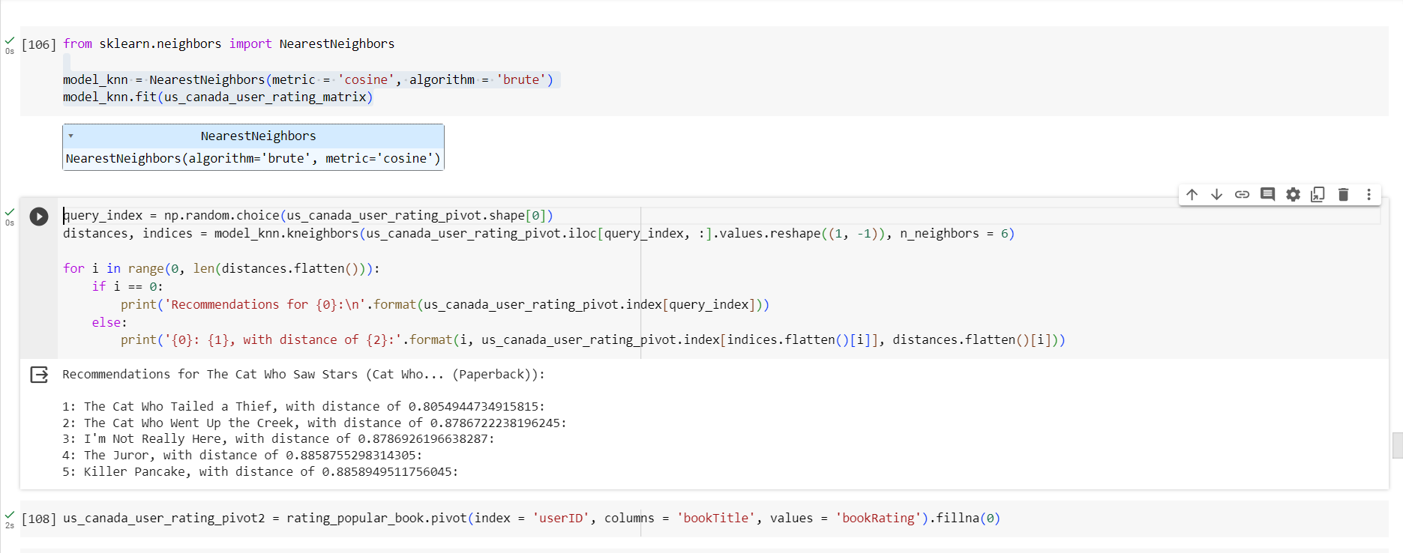
Nearest Neighbors

Slide 27
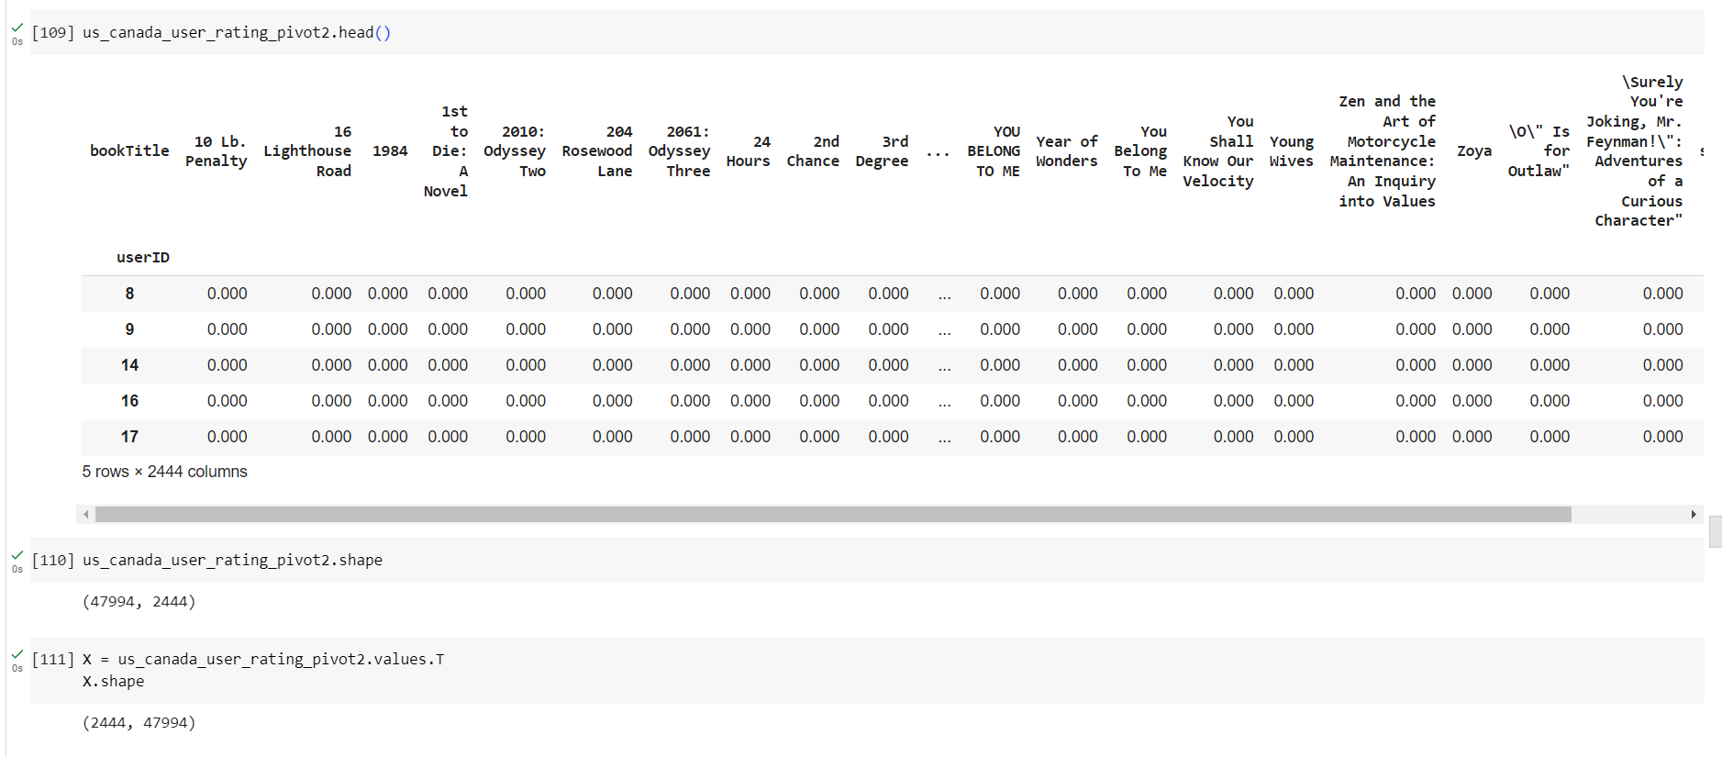

Slide 28
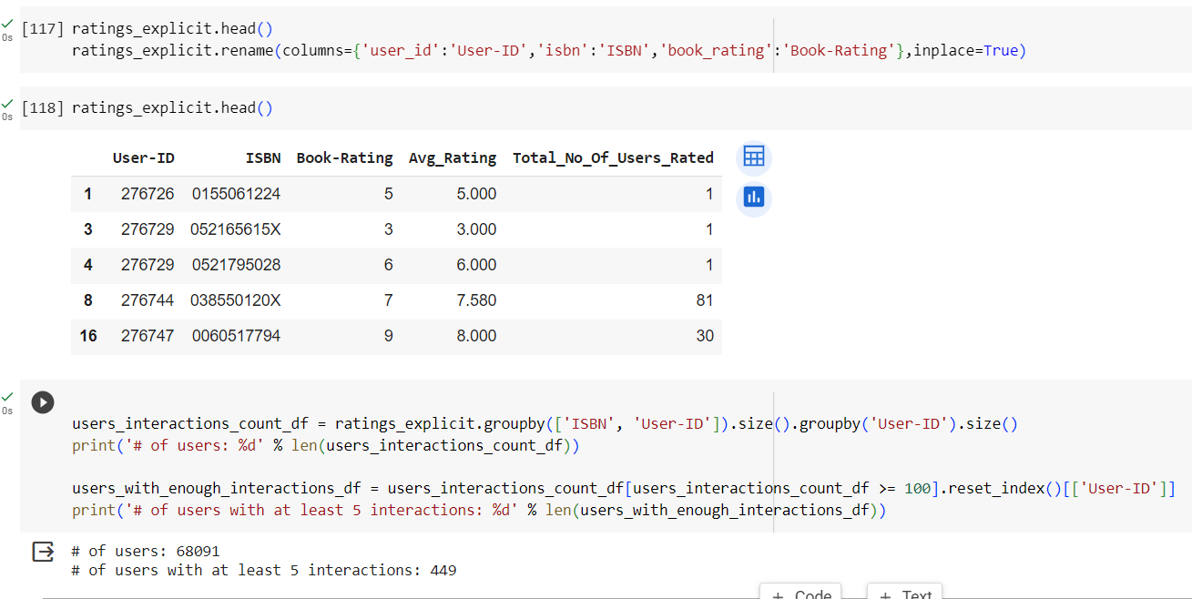
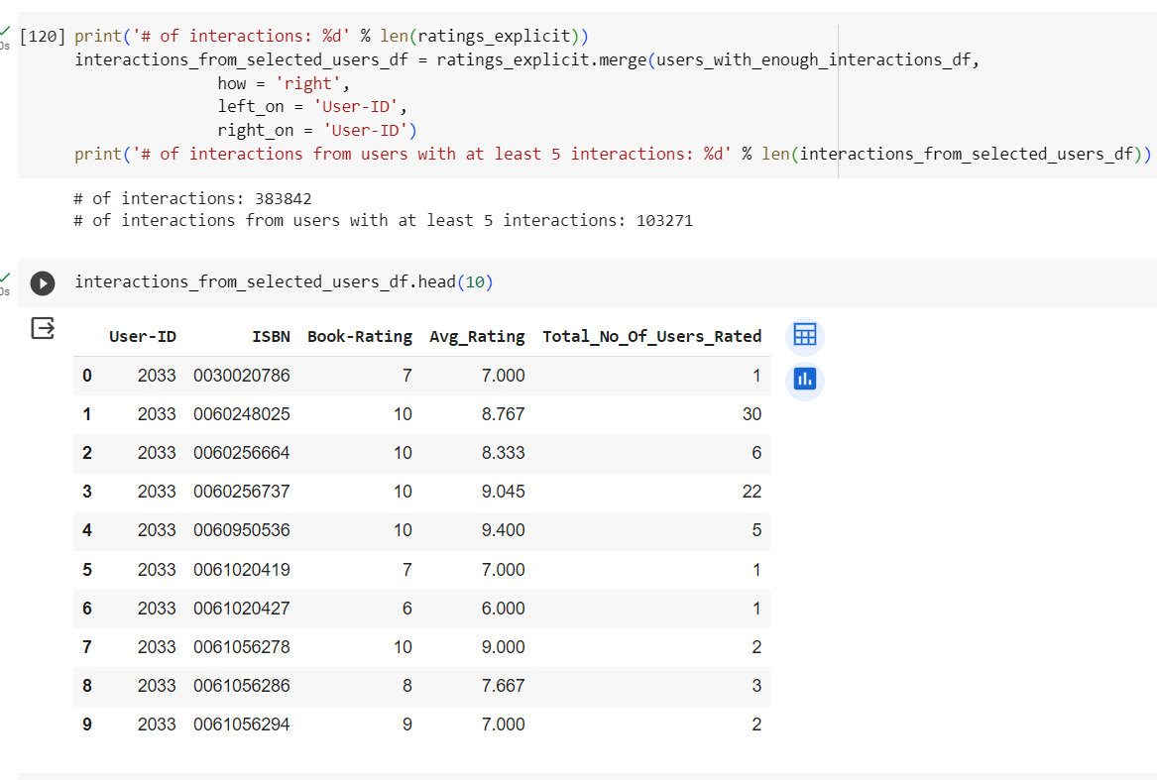
Collaborative Filtering based(User-Item based)

Slide 29
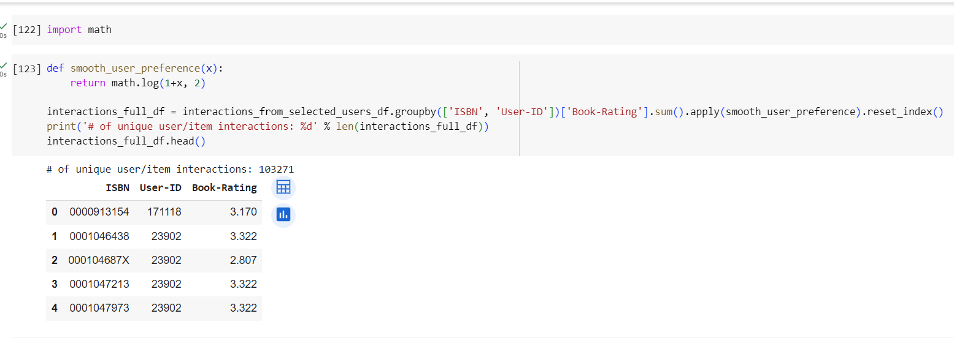
Item Interactions

Slide 30
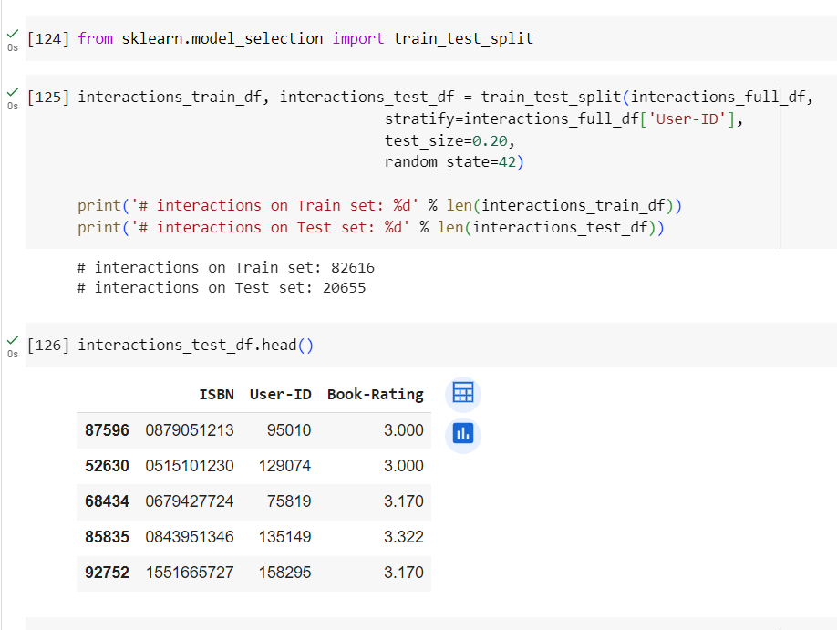
Interaction on train set and test set

Slide 31
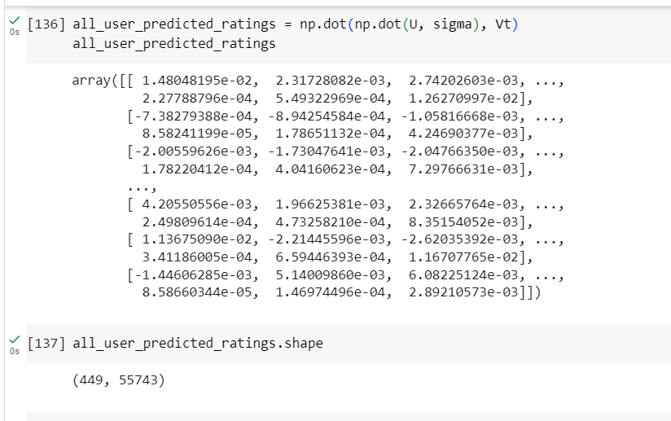
After the factorization, we try to to reconstruct the original matrix by multiplying its factors. The resulting matrix is not sparse any more. It was generated predictions for items the user have not yet interaction, which we will exploit for recommendations

Slide 32
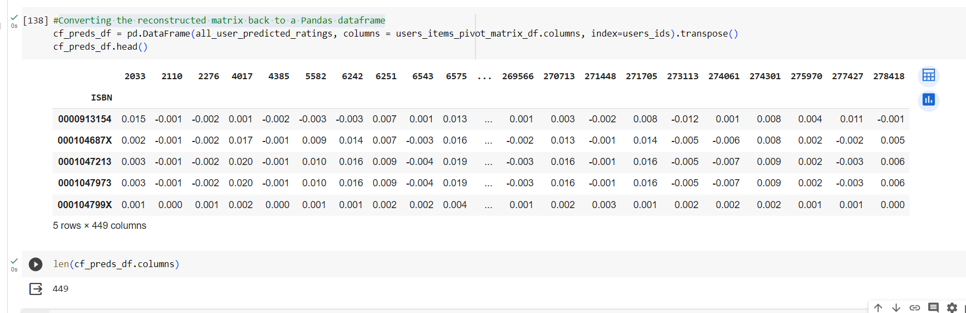
Converting the reconstructed matrix back to a Pandas dataframe

Slide 33
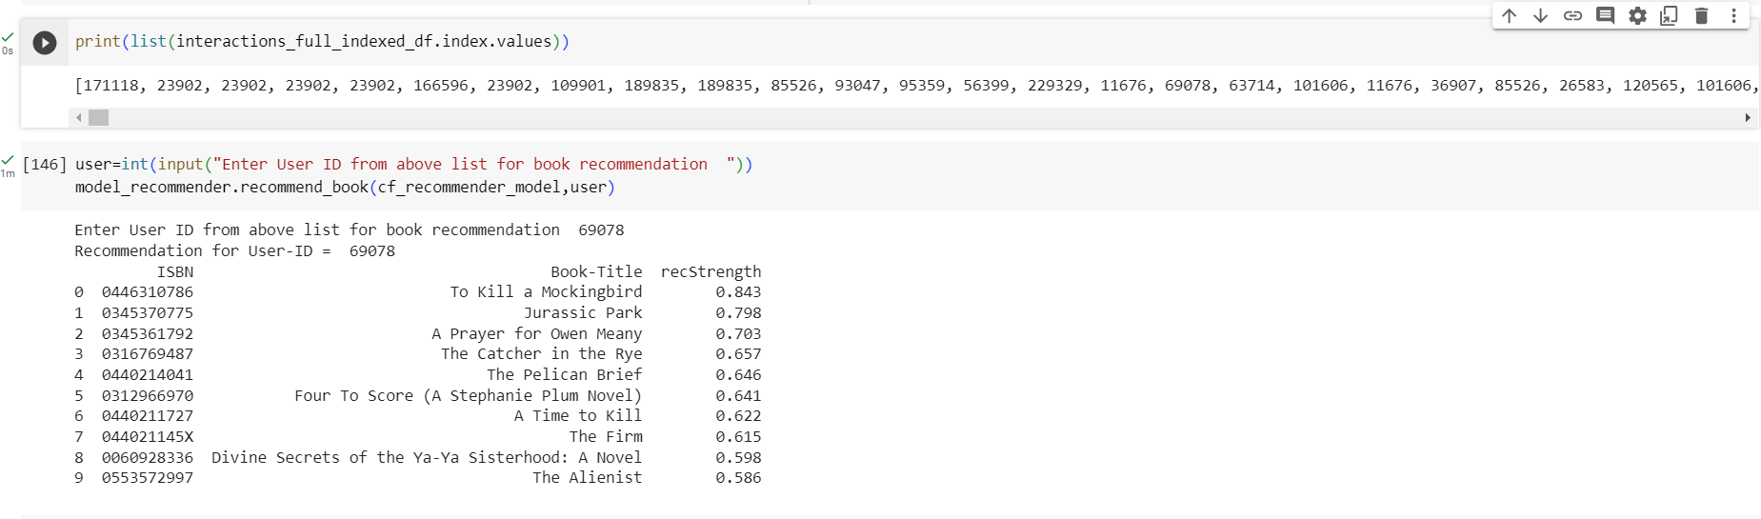
User-Id 69078 and see the results

Slide 34
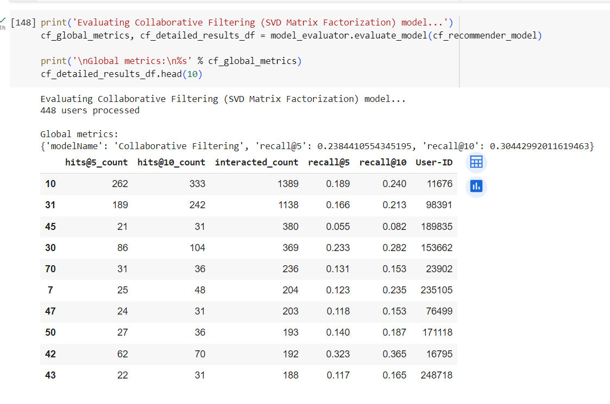
Evaluate In Recommender Systems, there are a set metrics commonly used for evaluation. We choose to work with Top-N accuracy metrics, which evaluates the accuracy of the top recommendations provided to a user, comparing to the items the user has actually interacted in test set.

Slide 35

DEVPLOYMENT

Slide 36


Slide 37
Challenges faced
Data set has huge amount of data files.
Decision making on missing value imputations and outlier treatment was quite challenging as well.
Deployment of code .

Slide 38
How we overcame
By doing some analysis and selecting out more informative data files will help to build better system.
Filtering out datasets and removing outliers will help us to build more concrete content-based systems.

Slide 39
Conclusion
In EDA, the Top-10 most rated books were essentially novels. Books like The Lovely Bone and The Secret Life of Bees were very well perceived.
Majority of the readers were of the age bracket 20-35 and most of them came from North American and European countries namely USA, Canada, UK, Germany and Spain.
If we look at the ratings distribution, most of the books have high ratings with maximum books being rated 8. Ratings below 5 are few in number.
Author with the most books was Agatha Christie, William Shakespeare and Stephen King.
For modelling, it was observed that for model based collaborative filtering SVD technique worked way better than NMF with lower Mean Absolute Error (MAE) .
Amongst the memory based approach, item-item CF performed better than user-user CF because of lower computation .

Slide 40
THANK YOU
.

